Slide 1
Advanced Blog Training
Why You Should Care About Page Load Times
And How To Improve Them
January 2019
By Dave Foreman

Slide 2
Why You Should Care About Page Load Times
Page load times are often ignored in SEO discussions and grading tools in spite of the fact that this search engine ranking factor has only increased with time.
As websites add more and more plugins and tracking scripts, the amount of resources on the page increase and cause load times to slow dramatically.
Most people feel that their website loads "fast enough” but studies by Bing and others have shown that small improvements page load times can have a dramatic effect on bounce rates.
| IMPROVE PAGE LOAD TIMES
Notes:
https://blog.hubspot.com/marketing/page-load-time-conversion-rates

Slide 3
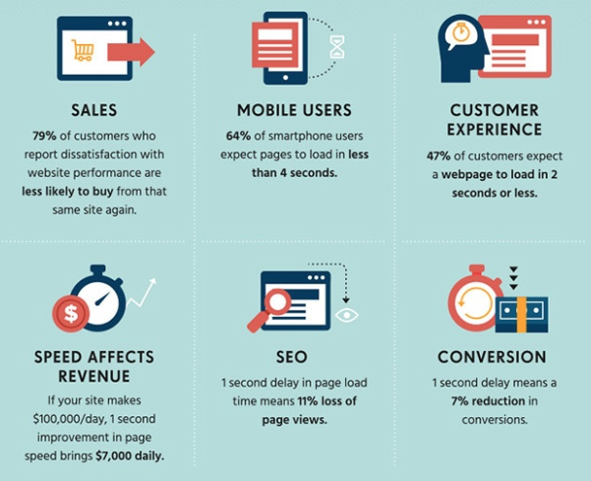
12 Case Studies Show Improved Effects After Optimizing Page Load Time
View the full infographic here >>
| IMPROVE PAGE LOAD TIMES
Notes:
https://blog.hubspot.com/marketing/page-load-time-conversion-rates

Slide 4
INCREASE THE SPEED OF YOUR SITE WITH
And If you use WordPress Also Use:
| IMPROVE PAGE LOAD TIMES

Slide 5
What is Cloudflare?
A free global content delivery network (CDN) that lets your website work faster and keeps it secure
By caching and optimizing web site content, Cloudflare improves page load speeds, reduce bandwidth usage, and reduce CPU usage on the server.
Cloudflare improves security by hiding your site’s IP address and by blocking many threats before they reach your site.
| IMPROVE PAGE LOAD TIMES

Slide 6
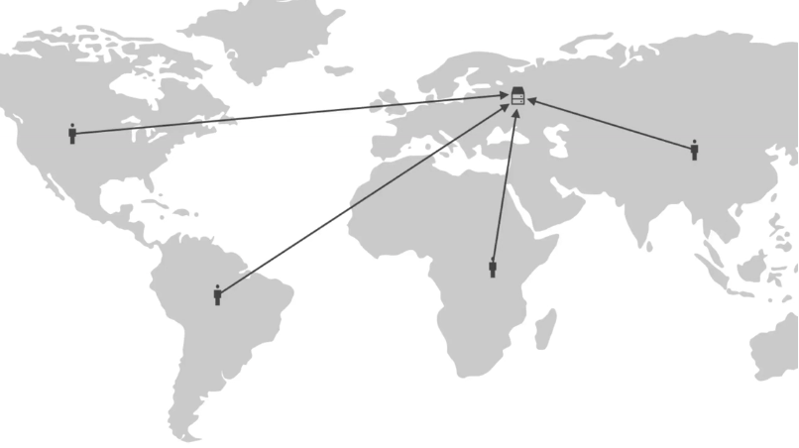
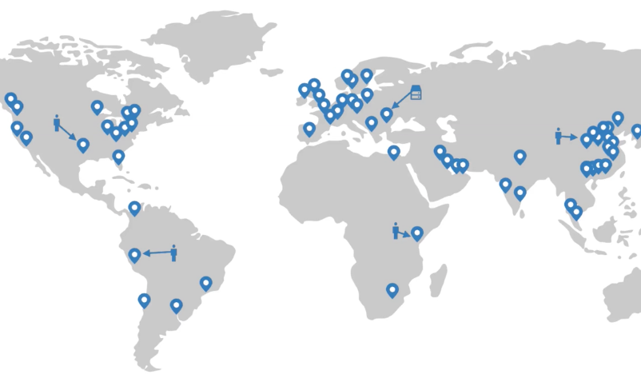
Cloudflare POPS
POPS are Points of Presence
Without Cloudflare POPS (single server)
With Cloudflare POPS
(many servers)
| IMPROVE PAGE LOAD TIMES

Slide 7
Take Full Advantage of Cloudflare’s Performance Features
Set up a free account at Cloudflare.com, activate your domain, and make sure you activate the correct DNS Records.*
Turn on services and add “page rules” as needed to protect your website and speed up page load times.
If your website uses WordPress you can link to WPRocket and turn on “Optimal Settings” in the Cloudflare Add-On
* This may result in downtime for your email and be very cautious if you have complex DNS Records
| IMPROVE PAGE LOAD TIMES

Slide 8
Watch These Videos Take Full Advantage of Cloudflare’s Performance Features - DNS
CloudFlare Set up video
Setting up free HTTPS and forcing HTTPS
Setting up special page rules for login pages on any site ( See Item #4)
Installing the WordPress Plugin and optimizing (don’t use if using WP-Rocket)
| IMPROVE PAGE LOAD TIMES

Slide 9
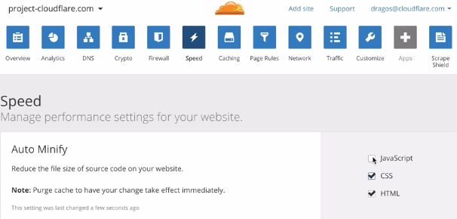
Cloudflare’s Performance Features – AUTO MINIFY
If you don’t use WordPress go to the Speed section to Auto Minify your code. This reduces the file size of your HTML, CSS and JavaScript files by removing all of the blank spaces—all without having to touch a single line of code.
| IMPROVE PAGE LOAD TIMES

Slide 10
What is WP Rocket?
A paid plugin for WordPress with dozens of options that make page load optimization quick and easy
Download it here and ask Dave for access to support under ERP & CRM Blog’s Unlimited Support Plan
You are free to use our Group plan for as long as you are a member of the blogs
Or sign up for Interactive Limited’s Monthly Website Maintenance Plan. Setup and Maintenance of WP Rocket is Included along with dozens of other maintenance items.
| IMPROVE PAGE LOAD TIMES

Slide 11
WP Rocket Options
Cloudflare Add-on
Caching
Pre Loading
Lazy Loading
File Optimization beyond Cloudflare
Much More
| IMPROVE PAGE LOAD TIMES

Slide 12
For questions, contact:
David Foreman
dave@interactivelimited.com
Brittany Farley
brittany@interactivelimited.com
Phone: 888-800-0999

